Slide 2
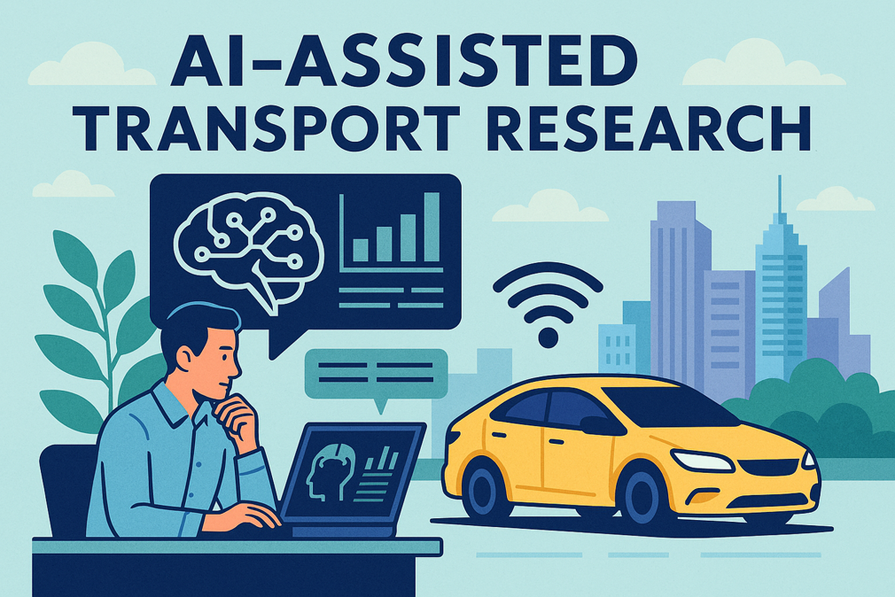
Otto Anker Nielsen

Slide 3
Why AI Matters Now?
Increasing pressure on publication and funding
“Competitors” use AI big-time
Will lead to better written, more compliant competitive applications
Rapid growth in data and complexity
Administrative workload and requirements are increasing
AI offers productivity, insight, and scalability
👉 Key question: How can researchers effectively use AI without compromising quality?

Slide 4
Where AI may help Most?
Writing & publishing
Mathematical modelling & data analysis
Administrative and project tasks

Slide 5
AI for writing
Language control and proof reading
Editing documents, e.g. propose how to reduce length of documents, avoiding repetitions
Improving clarity and conciseness
Explaining complex theories in simpler terms
Writing abstracts, summaries, review sections
Checking and suggesting references

Slide 6
AI for literature review
Literature mapping: Summarizing large volumes of papers and identifies gaps
Connecting ideas across fields (e.g., transport + behavioral science)
Cluster literature into themes or categories and structuring review sections
Identifying contradictions or research gaps
BUT be aware of possible
Hallucinated or incorrect references, wrong interpretation of reviews
Lack of scientific rigor

Slide 7
AI in the publication process
Identifying relevant journals based on abstract or paper draft, and possible recommending rescoping paper
Note best to used downloaded trained LLM not to reveal the content of the paper
Creating submission packages
Letter to the editor
Formatting to specific journal format and upload requirements,…
Help suggesting reviewers
Responses to reviews
Draft response letters to review
Strengthening arguments after feedback, and drafting responses to reviewers
Rewriting paper sections based on comments

Slide 8
AI in peer review processes
Has changed review processes for good or bad
Journals autogenerate proposals of reviewers who are not always relevant
Reviewers use AI to generate reviews (some universities have #reviews as PKIs, publishers has began counting this),…
Automation in low-quality journals

Slide 9
AI for mathematical research
Symbolic Mathematics & Derivations
Solving equations (algebraic, differential, integral)
Performing symbolic derivations step-by-step
Simplifying complex expressions
Helping to proof hypothesis or verifying mathematical proofs or steps
Numerical computations and simulations
Refine complex model systems
Pattern discovery and data-driven insights
Code generation
BUT be aware of possible
Errors in reasoning and mathematics
Lack of scientific rigor

Slide 10
AI for data analysis
Data Interpretation & Explanation
Detecting and/or cleaning outliers
Translating results into clear narratives
Suggesting interpretations of statistical outputs
Creating and explaining figures, tables, and patterns
Linking findings to existing literature

Slide 11
Use of AI as a research method
AI assistance when formulating models, testing and refining model specifications
Enhancing models predictive power (e.g. model-based ML)
ML as a learning method within optimization models, when solving bi-level problems, wider range of fixed-point problems (equilibrium in model systems)
LLMs for processing qualitative data like survey answers, POIs evaluations etc.
Possible to quantify new type of data sources
Image recognition and classification
Virtual reality and simulators
BUT when using ML and “brute force calculations” one may forget laws from physics, statistics, economics,…

Slide 12
AI in Grant Writing (Pre-Award)
Help structuring proposals
Draft administrative sections in proposals (impact, dissemination, project management)
Sometime AI knows specific call-requirements (like for DUT, Horizon). Seems better trained for large repetitive calls, than niche calls (like DFF green call)
Summarizing call requirements
Ensure compliance with guidelines (both the scientific call text, and other requirements)
Our applications often fail on specific ignored requirements, e.g. Marie Curie applications ignoring training and/or secondment aspects
Funding support; learn patterns from winning and rejected grants, and rejection letters
Help making presentations based on proposals, e.g. in powerpoint

Slide 13
AI in Project Management (Post-Award)
Assist with reporting and progress updates
Classifies and tags research documents and data
Taking notes and summaries from meetings (e.g. MeetGeek type of tools, etc.)
Be aware of GDPR and ethics of this
Generate data management plan from the application (should be possible?)
Help identifying issues in grant agreement, consortia agreements
Help with arguments related to GDPR, legal, etc.
Reporting & Compliance
Keep tracks deadlines and submission requirements
Periodic project reports
Summarize milestones and deliverables
Helps ensuring compliance with funding rules

Slide 14
Administrative Automation
Helps in recruitment
Systematic call distribution
Sorting and ranking applications
Summarize long email threads
Workflow automation

Slide 15
⚖️ Limitations of AI (AI generated)
Hallucinated or incorrect references, wrong interpretation of reviews
Errors in reasoning and mathematics
Lack of scientific rigor
Bias in training data
Ethical concerns (authorship, transparency)
👉 AI requires critical human oversight

Slide 16

🎯 Key Takeaways (AI generated)
AI may significantly increases research productivity
Strongest in writing, data analysis, and admin tasks
Useful for augmentation, not replacement
Critical thinking remains essential
👉 AI is a co‑pilot — not the researcher

